Slide 1
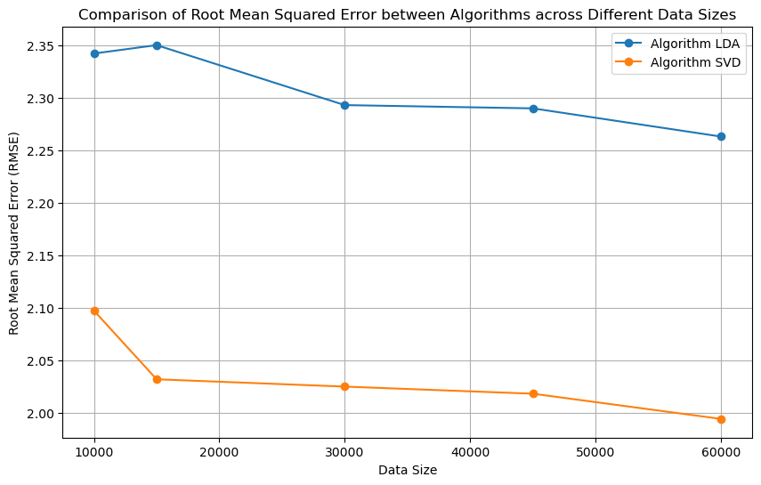
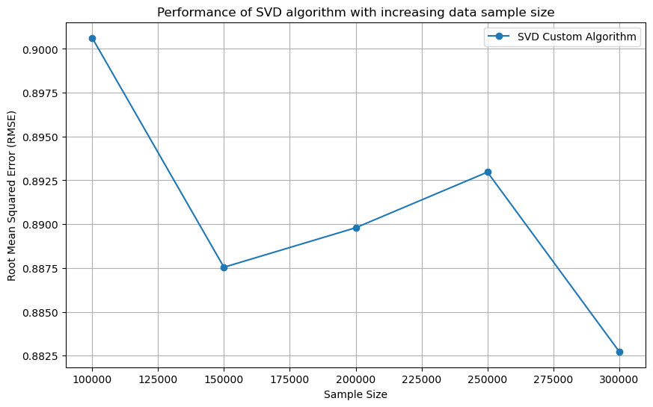

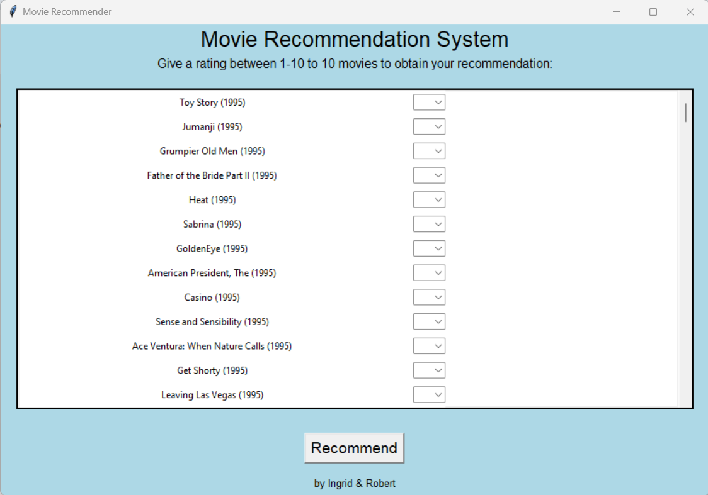
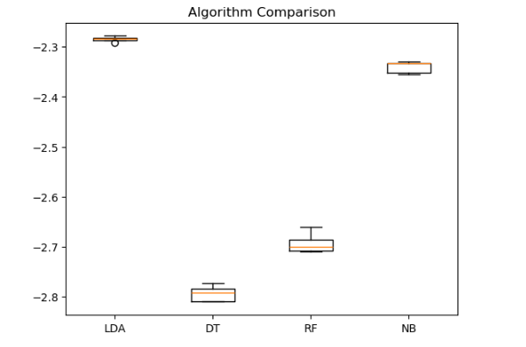
Capstone Project
Movie recommendation System
Ingrid Castro and Robert Szlufik, CCT College Dublin, May 2024
ABSTRACT
Stage 2 – Data Understanding
From the models tested we chose to optimise the best of them, the LDA, and then compare it with the performance of another algorithm: SVD. This algorithm, also known as Singular Value Decomposition, is effective and commonly used in recommendation systems. We then put the results in a graph and even the initial results were already quite satisfactory:
Systems that leverage, both collaborative filtering and prediction estimation, might further benefit from the fact that users are biassed toward their preferences. With this hybrid model, we are combining the best from both approaches, we take into account what similar users like, and tilt toward their preferences and simultaneously, try to expand the pool of movies to recommend by predicting rating across the entire final set.
This project is focused on implementing a Movie Recommendation System with the use of Machine Learning. The system was developed in Python and the datasets used were 'Movies' and 'Ratings' from MovieLens 25M. This project was developed with the CRISP-DM methodology and each of the phases is detailed in a report and Jupyter Notebook.
The system is a hybrid combining best qualities of collaboration filtering and user grouping. In the project we compare some models accuracies, upgrade a chosen model and show the improved performance of our hybrid model, that used the SVM algorithm. We are able to find recommended movies based on user ratings.
On our Data Understanding phase we determined that we would be working with two datasets from Movielens 25M: 'Movies' and 'Ratings'. The specifics of each dataset were:
‘Movies’ dataset contains 62.423 rows and 3 columns;
Columns are: ‘movieId’ (int64), ‘title’ (object) and ‘genres’ (object);
No duplicate values;
No null values;
No NA values;
'Ratings' dataset contains 25.000.095 rows and 4 columns;
Columns are: 'userId' (int64), 'movieId' (int64), 'rating' (float64), 'timestamp' (int64);
No duplicate values;
No null values;
No NA values;
The data quality of these datasets was very good and allowed us to do some Data Preparation mostly to prepare data for modelling, not to deal with missing values and/or null or NA values. Data visualisations were also included on the report.
Stage 6 - Deployment
For the deployment phase we started by generating a dataframe with estimated rating as a preprocessing step and named it 'df_estimated'. This dataset generates rating predictions in advanced so when we run our application it does not have to run for a longer period period of time. This dataset has 3 columns ('UserId', 'movieId' and 'rating') and more than 95M rows. It contains 588 movies and 162k unique users, giving us enough amplitude to recommend movies from there and eliminate some possible biases.
After this first step, we did a function called 'find_similar_users' that uses cosine similarity to find users that rated movies in a similar way that we did (or will do) when using the app. This allows us to see how these users rated other movies and use their rating as a recommendation mechanism for us. To validate our model we created a random user, gave this user random ratings to random movies and compared it to other 9 similar users.
This allowed us to create a decrescent dataset entitled 'sorted_df' with estimated ratings for all the movies presents in the 'df_estimated' dataset (588 movies with 10k+ ratings). This enables us to create a class 'Recommender' to be used in our last item: Our GUI. Where our user can give a rating between 1-10 to how many movies they want (we recommend 10) and obtain a decrescent list of titles.
PROJECT OBJECTIVES
The two objectives below represent the core focus of the entire project:
Objective 1: Develop a system that provides accurate movie recommendations for users, with minimal time needed to produce them.
Objective 2: Create a working prototype for our recommendation system.
Stage 3 – Data Preparation
Fig 4.2 - Comparison of RMSE on LDA and SVD in different data sizes
CONCEPTUAL FRAMEWORK
In the Data Preparation phase we started preparing the data for our fourth phase (Modelling). Since there was no need for dealing with missing, NA and null values, we focused our efforts in getting more numerical variables from our categorical ones.
For 'movies' we encoded the genres, adding 19 new columns with int64 being its datatype. We also added the 'genre_count' column, as int64 and the 'year' column also as int64.
For 'ratings' we dropped the 'timestamp' column.
We then merged the datasets, excluding the 'genres' column and having a dataset called 'merged' with 25 columns and 25M rows.
After that we were moving back and fourth on modelling and data preparation phases, since we would always get to train/ test/ split the data and scale it as we see fit.
When the decrease of Root Mean Square Error was observed within bigger data sizes we decided to do further testing to assure that the decreasing trend would maintain its descent and that the quality of the model would increase. This is how the model performed with sample sizes of a 100k to 300k rows:
As our Conceptual Framework we chose Crisp-DM, that is an ideal methodology when dealing with machine learning and data mining projects. It consists of an interactive process where we would define our business goals and what is the market for our product, understand the data, treat and prep it for modelling. After the modelling phase we do an evaluation of the full work and then deploy it, reflecting onto the process as a whole.
Stage 4 - Modelling
For our modelling phase we started thinking about our alternatives in terms of algorithms. We learned about the types of recommendation systems: Collaborative Filtering, Content Filtering, Context Filtering and Hybrid models. It was a discovery process to get to the final result. We tested the performance of Linear Discriminant Analysis (LDA), Decision Tree Regressor (DT). Random Forest Classifier (RF) and Gaussian Classifier (NB), because according to Portugal, Alencar and Cowan (2018) these were the most used algorithms in terms of a recommendation system. We observed how well they performed according to the RMSE (Root Mean Squared Error).
Fig 4.3 - Increased performance of SVD algorithm on bigger samples.
After these results, we trained our final model. There was some data preparation to filter movies with more than 10k ratings (this would allow us to tackle any bias in ratings) and create a final dataset: 'ratings_final'. This was trained and validated and we made a evaluation of its performance as the next phase of our project.
Fig. 6.1 - GUI
Stage 1 – Business Understanding
Stage 5 - Evaluation
CONCLUSIONS
For our business understanding phase we defined our objectives, thought of ours stakeholders and our deliverables. We wanted our model to be accurate, unbiased by the big industries, accessible for the general public and also fill the gap in the movie recommendation industry, that is usually linked with big streaming companies.
In terms of technologies used, we opted for open source solutions and used libraries such as: pandas, numpy, matplotlib, seaborn, sklearn, pickle and tkinter to accomplish our development goals. We also divided our responsibilities so each would participate in every phase of development but would focus in some of them, so we could both develop and deliver this project within a 2-month deadline. On our report we also explore the legal and ethical issues as well as data collection methodology – all according to GDPR and the Digital Services Act.
As a reflection of our overall project development we can say that both objectives were reached and we were able not only to provide the source code for our system (including multiple trained models), but also a User Interface that is able to show the real life usage of the system.
The project amplified our understanding of the technologies used and explored an alternative approach to this task, since there are many available. The CRISP-DM methodology helped us structuring our research and development steps, as well as made it easier for us to set internal deadlines for certain phases that required more or less time to be completed.
In the evaluation phase we did the assessment of the results of our final model. We could observe that the testing set had an RMSE of 0.895, while the training set had a 0.891 Root Mean Squared Error – way better than the initial indices of 2.24 for the LDA algorithm and 2.04 for the SVD (in a smaller sample of the data).
With that assessment we are proved that not only the use of the SVD algorithm already upgraded the efficiency of our model in smaller samples of data, but also got even better results at a bigger sample, which is what we have. With that, 0.89 points up or down.
Another important factor is that the final prediction consists of an average across several users. This might potentially mitigate inaccuracies in predictions for a single user.
REFERENCES
Fig 4.1 - Models comparison on RMSE scale.
Full reference list with all references of the project:
https://www.mybib.com/b/yKNwZN

